Slide 1
虛擬化技術 Virtualization and Virtual Machines
Storage Virtualization

Slide 2
Agenda
Overview
Introduction
What to be virtualized
Where to be virtualized
How to be virtualized
Case study
On linux system
RAID
LVM
NFS
In distributed system
Vastsky
Lustre
Ceph
HDFS

Slide 3
Overview
Introduction
What to be virtualized ?
Block, File system
Where to be virtualized ?
Host-based, Network-based, Storage-based
How to be virtualized ?
In-band, Out-of-band

Slide 4
Storage Virtualization
Introduction
What to be virtualized
Where to be virtualized
How to be virtualized
Case study

Slide 5
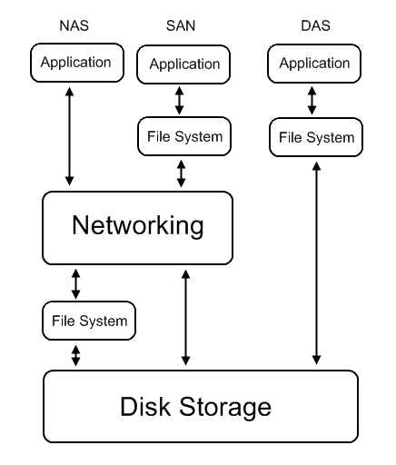
Introduction
Common storage architecture :
DAS - Direct Attached Storage
Storage device was directly attached to a server or workstation, without a storage network in between.
NAS - Network Attached Storage
File-level computer data storage connected to a computer network providing data access to heterogeneous clients.
SAN - Storage Area Network
Attach remote storage devices to servers in such a way that the devices appear as locally attached to the operating system.

Slide 6
Introduction
Desirable properties of storage virtualization:
Manageability
Storage resource should be easily configured and deployed.
Availability
Storage hardware failures should not affect the application.
Scalability
Storage resource can easily scale up and down.
Security
Storage resource should be securely isolated.

Slide 7
Introduction
Storage concept and technique
Storage resource mapping table
Redundant data
Multi-path
Data sharing
Tiering

Slide 8
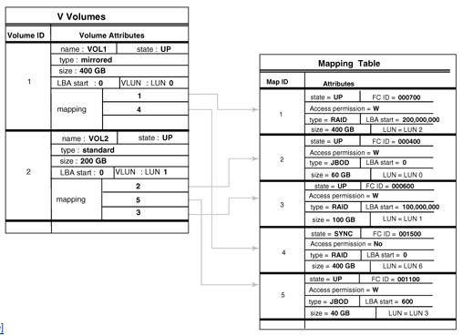
Concept and Technique
Storage resource mapping table
Maintain tables to map storage resource to target.
Dynamic modify table entries for thin provisioning.
Use table to isolate different storage address space.

Slide 9
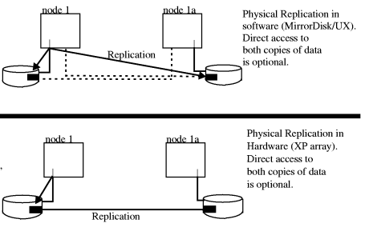
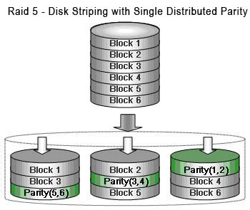
Concept and Technique
Redundant data
Maintain replicas to provide high availability.
Use RAID technique to improve performance and availability.

Slide 10
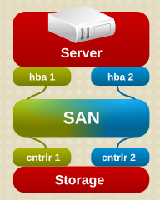
Concept and Technique
Multi-path
A fault-tolerance and performance enhancement technique.
There is more than one physical path between the host and storage devices through the buses, controllers, switches, and bridge devices connecting them.

Slide 11
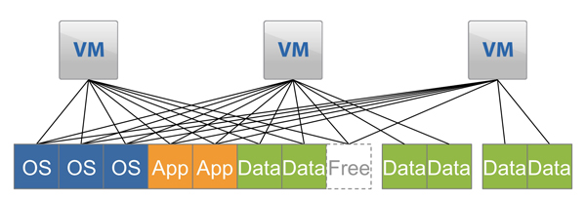
Concept and Technique
Data sharing
Use data de-duplication technique to eliminate duplicated data.
Save and improve the usage of storage space

Slide 12
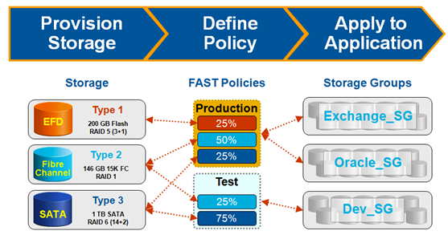
Concept and Technique
Tiering
Automatic migrate data across storage resources with different properties according to the significance or access frequency of data.
Example: iMac fusion drive
Storage
Policies
Access Group

Slide 13
Storage Virtualization
Introduction
What to be virtualized
Where to be virtualized
How to be virtualized
Case study

Slide 14
What To Be Virtualized
Layers can be virtualized
File system
Provide compatible system call interface to user space applications.
Block device
Provide compatible block device interface to file system.
Through the interface such as SCSI, SAS, ATA, SATA, etc.
User Space
Application
System call interface
Kernel Space
File System
Block interface
Device driver
Storage Device

Slide 15
File System Level
Data and Files
What is data ?
Data is information that has been converted to a machine-readable, digital binary format.
Control information indicates how data should be processed.
Applications may embed control information in user data for formatting or presentation.
Data and its associated control information is organized into discrete units as files or records.
What is file ?
Files are the common containers for user data, application code, and operating system executables and parameters.

Slide 16
File System Level
About the files
Metadata
The control information for file management is known as metadata.
File metadata includes file attributes and pointers to the location of file data content.
File metadata may be segregated from a file's data content.
Metadata on file ownership and permissions is used in file access.
File timestamp metadata facilitates automated processes such as backup and life cycle management.
Different file systems
In Unix systems, file metadata is contained in the i-node structure.
In Windows systems, file metadata is contained in records of file attributes.

Slide 17
File System Level
File system
What is file system ?
A file system is a software layer responsible for organizing and policing the creation, modification, and deletion of files.
File systems provide a hierarchical organization of files into directories and subdirectories.
The B-tree algorithm facilitates more rapid search and retrieval of files by name.
File system integrity is maintained through duplication of master tables, change logs, and immediate writes off file changes.
Different file systems
In Unix, the super block contains information on the current state of the file system and its resources.
In Windows NTFS, the master file table contains information on all file entries and status.

Slide 18
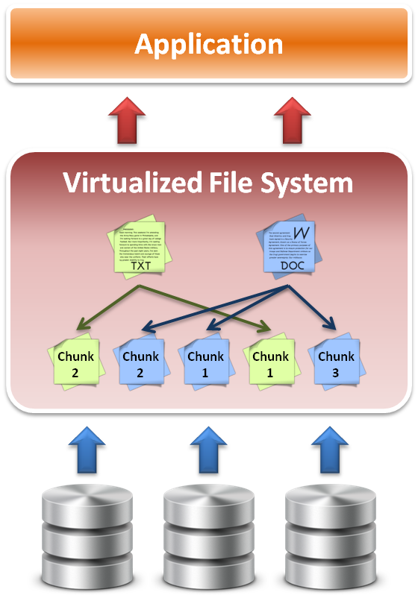
File System Level
File system level virtualization
File system maintains metadata (i-node) of each file.
Translate file access requests to underlining file system.
Sometime divide large file into small sub-files (chunks) for parallel access, which improves the performance

Slide 19
Block Device Level
Block level data
The file system block
The atomic unit of file system management is the file system block.
A file's data may span multiple file system blocks.
A file system block is composed of a consecutive range of disk block addresses.
Data in disk
Disk drives read and write data to media through cylinder, head, and sector geometry.
Microcode on a disk translates between disk block numbers and cylinder/head/sector locations.
This translation is an elementary form of virtualization.

Slide 20
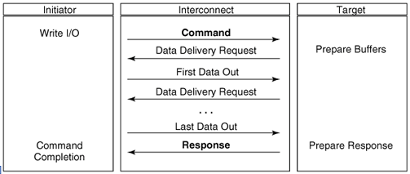
Block Device Level
Block device interface
SCSI (Small Computer System Interface)
The exchange of data blocks between the host system and storage is governed by the SCSI protocol.
The SCSI protocol is implemented in a client/server model.
The SCSI protocol is responsible for block exchange but does not define how data blocks will be placed on disk.
Multiple instances of SCSI client/server sessions may run concurrently between a server and storage.

Slide 21
Block Device Level
Logical unit and Logical volume
Logical unit
The SCSI command processing entity within the storage target represents a logical unit (LU) and is assigned a logical unit number (LUN) for identification by the host platform.
LUN assignment can be manipulated through LUN mapping, which substitutes virtual LUN numbers for actual ones.
Logical volume
A volume represents the storage capacity of one or more disk drives.
Logical volume management may sit between the file system and the device drivers that control system I/O.
Volume management is responsible for creating and maintaining metadata about storage capacity.
Volumes are an archetypal form of storage virtualization.

Slide 22
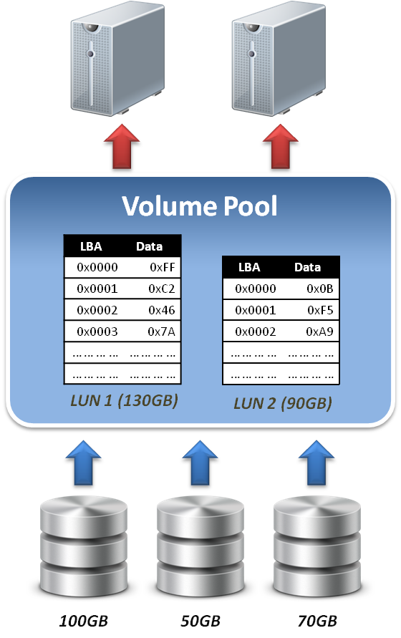
Block Device Level
Data block level virtualization
LUN & LBA
A single block of information is addressed using a logical unit identifier (LUN) and an offset within that LUN, which known as a Logical Block Address (LBA).
Apply address space remapping
The address space mapping is between a logical disk and a logical unit presented by one or more storage controllers.

Slide 23
Storage Virtualization
Introduction
What to be virtualized
Where to be virtualized
How to be virtualized
Case study

Slide 24
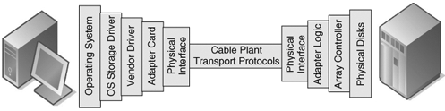
Where To Be Virtualized
Storage interconnection
The path to storage
The storage interconnection provides the data path between servers and storage.
The storage interconnection is composed of both hardware and software components.
Operating systems provide drivers for I/O to storage assets.
Storage connectivity for hosts is provided by host bus adapters (HBAs) or network interface cards (NICs).

Slide 25
Where To Be Virtualized
Storage interconnection protocol
Fibre Channel
Usually for high performance requirements.
Supports point-to-point, arbitrated loop, and fabric interconnects.
Device discovery is provided by the simple name server (SNS).
Fibre Channel fabrics are self-configuring via fabric protocols.
iSCSI ( internet SCSI )
For moderate performance requirements.
Encapsulates SCSI commands, status and data in TCP/IP.
Device discovery by the Internet Storage Name Service (iSNS).
iSCSI servers can be integrated into Fibre Channel SANs through IP storage routers.

Slide 26
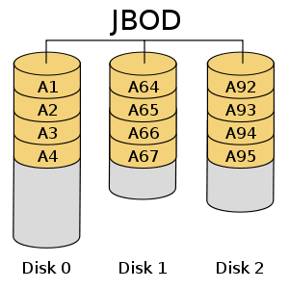
Where To Be Virtualized
Abstraction of physical storage
Physical to virtual
The cylinder, head and sector geometry of individual disks is virtualized into logical block addresses (LBAs).
For storage networks, the physical storage system is identified by a network address / LUN pair.
Combining RAID and JBOD assets to create a virtualized mirror must accommodate performance differences.
Metadata integrity
Storage metadata integrity requires redundancy for failover or load balancing.
Virtualization intelligence may need to interface with upper layer applications to ensure data consistency.

Slide 27
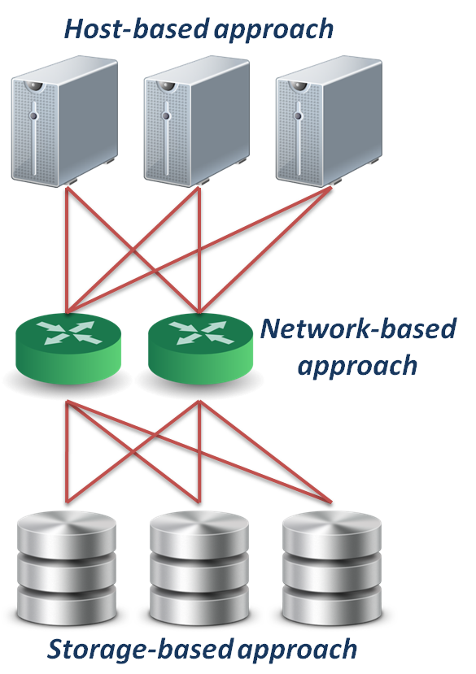
Where To Be Virtualized
Different approaches :
Host-based approach
Implemented as a software running on host systems.
Network-based approach
Implemented on network devices.
Storage-based approach
Implemented on storage target subsystem.

Slide 28


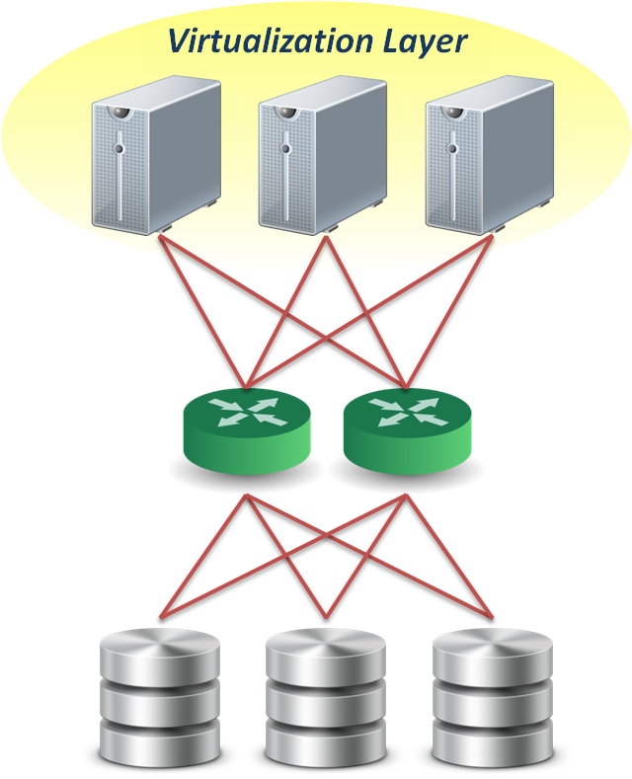
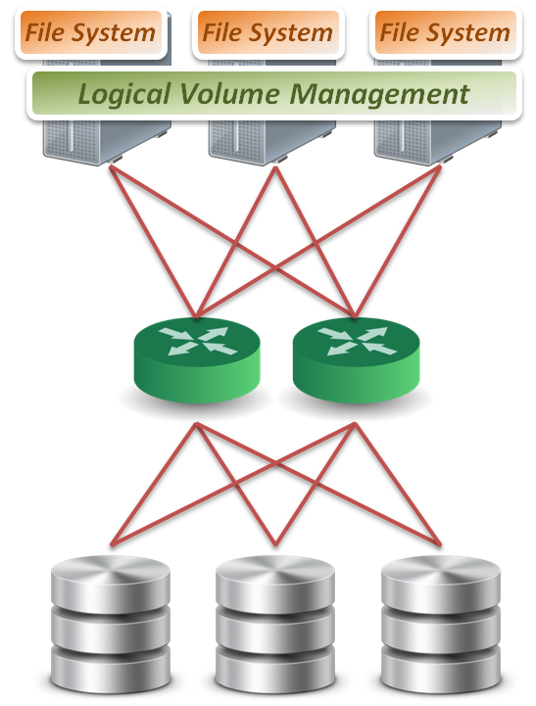
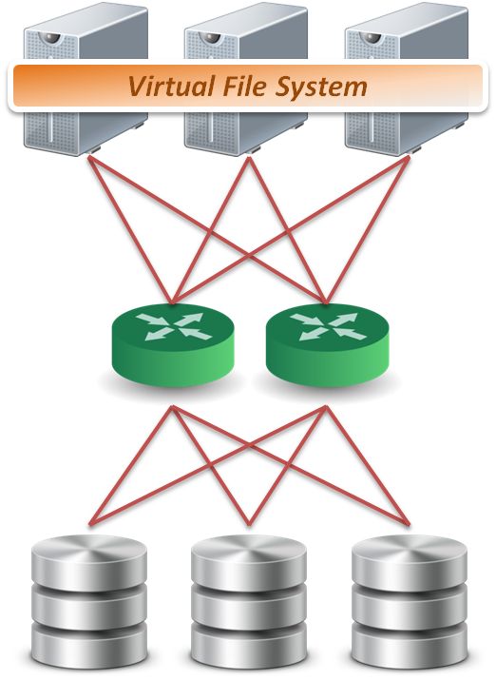

Host-based Virtualization
Host-based approach
File level
Run virtualized file system on the host to map files into data blocks, which distributed among several storage devices.
Block level
Run logical volume management software on the host to intercept I/O requests and redirect them to storage devices.
Provide services
Software RAID
Block 1
Block 2
Block 1
Block 2
Block 1
Sub-file 1
Sub-file 2
Sub-file 3

Slide 29
Host-based Virtualization
Important issues
Storage metadata servers
Storage metadata may be shared by multiple servers.
Shared metadata enables a SAN file system view for multiple servers.
Provides virtual to real logical block address mapping for client.
A distributed SAN file system requires file locking mechanisms to preserve data integrity.
Host-based storage APIs
May be implemented by the operating system to provide a common interface to disparate virtualized resources.
Microsoft's virtual disk service (VDS) provides a management interface for dynamic generation of virtualized storage.

Slide 30
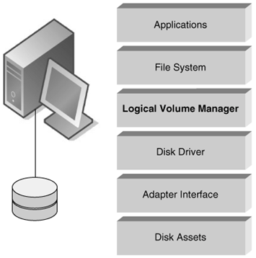
Host-based Virtualization
A typical example :
LVM
Software layer between the file system and the disk driver.
Executed by the host CPU.
Lack hardware-assist for functions such as software RAID.
Independence from vendor-specific storage architectures.
Dynamic capacity allocation to expand or shrink volumes.
Support alternate pathing for high availability.

Slide 31
Host-based Virtualization
Host-based implementation
Pros
No additional hardware or infrastructure requirements
Simple to design and implement
Improve storage utilization
Cons
Storage utilization optimized only on a per host base
Software implementation is dependent to each operating system
Consume CPU clock cycle for virtualization
Examples
LVM, NFS

Slide 32

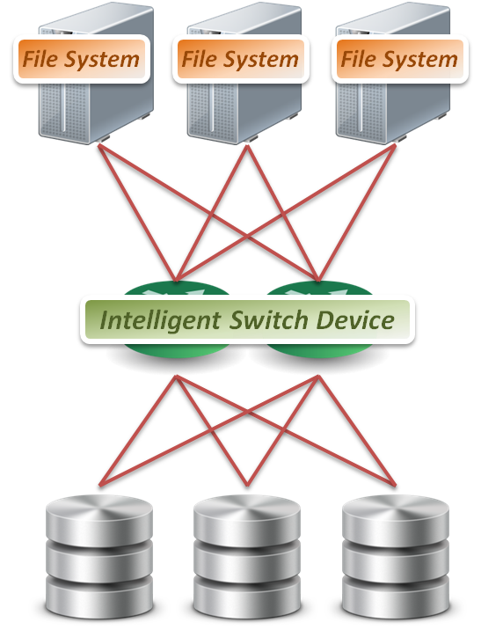
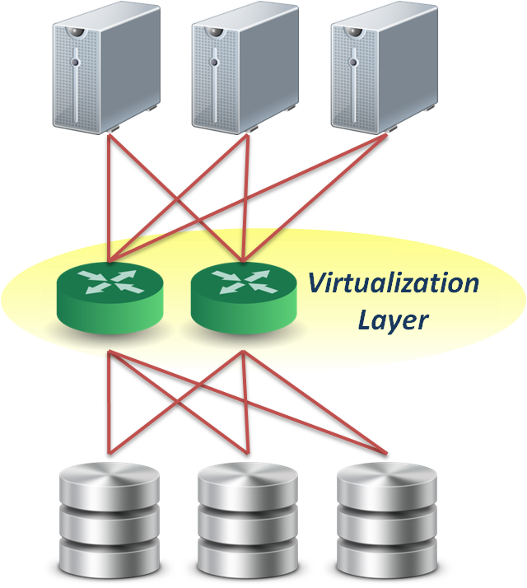
Network-based Virtualization
Network-based approach
File level
Seldom implement file level virtualization on network device.
Block level
Run software on dedicated appliances or intelligent switches and routers.
Provide services
Multi-path
Storage pooling
Block 1
Block 2
Block 1
Block 2
Block 1

Slide 33
Network-based Virtualization
Requirements of storage network
Intelligent services
Logon services
Simple name server
Change notification
Network address assignment
Zoning
Fabric switch should provide
Connectivity for all storage transactions
Interoperability between disparate servers, operating systems, and target devices

Slide 34
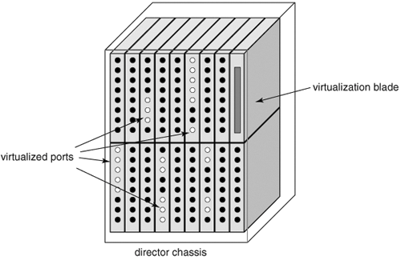
Network-based Virtualization
Techniques for fabric switch virtualization
Hosted on departmental switches
A PC engine provisioned as an option blade.
Data center directors
Should be able to preserve the five nines availability characteristic of director-class switches.
Dedicated virtualization ASICs provide high-performance frame processing and block address mapping.
Interoperability between different implementations will become a priority.

Slide 35
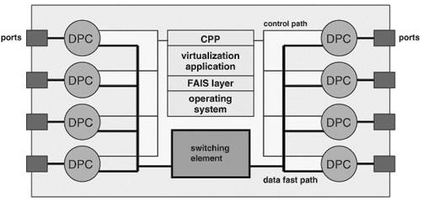
Network-based Virtualization
Interoperability issue
FAIS ( Fabric Application Interface Standard )
Define a set of standard APIs to integrate applications and switches.
FAIS separates control information and data paths.
The control path processor (CPP) supports the FAIS APIs and upper layer storage virtualization application.
The data path controller (DPC) executes the virtualized SCSI I/Os under the management of one or more CPPs

Slide 36
Network-based Virtualization
Network-based implementation
Pros
True heterogeneous storage virtualization
No need for modification of host or storage system
Multi-path technique improve the access performance
Cons
Complex interoperability matrices - limited by vendors support
Difficult to implement fast metadata updates in switch device
Usually require to build specific network equipments (e.g., Fibre Channel)
Examples
IBM SVC ( SAN Volume Controller ), EMC Invista

Slide 37

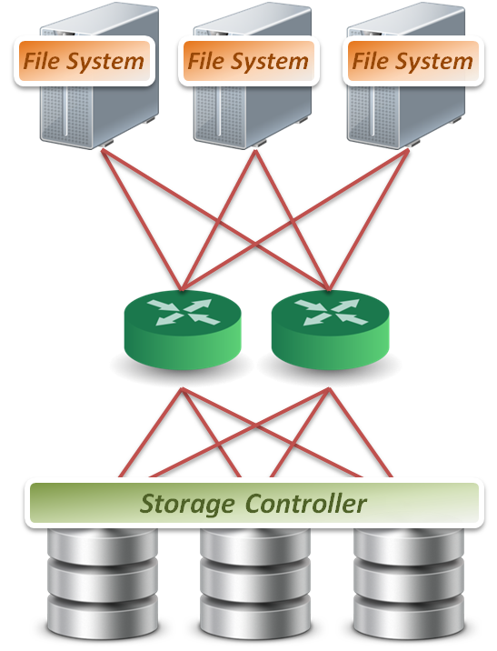
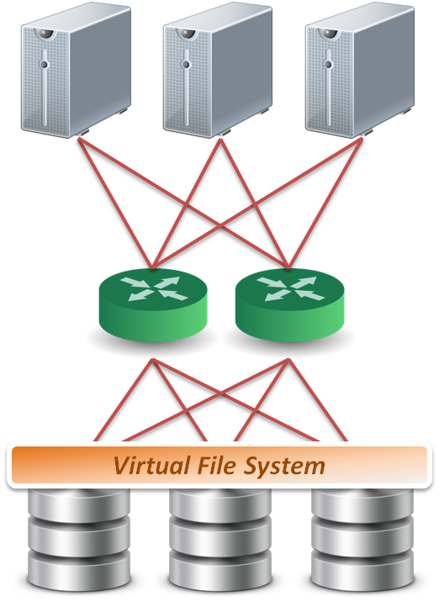
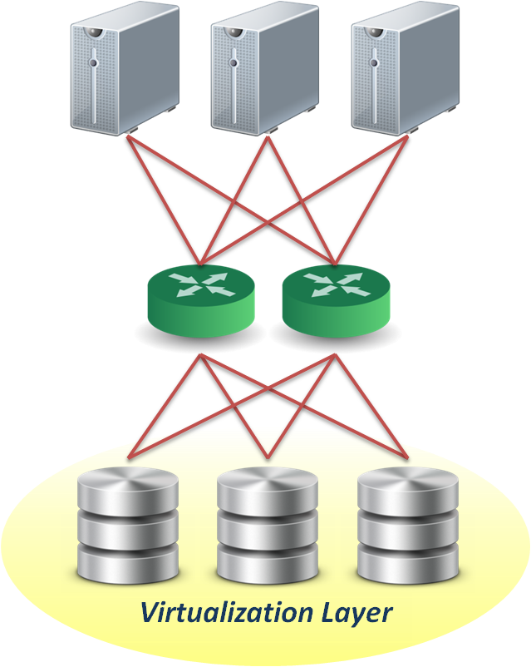
Storage-based Virtualization
Storage-based approach
File level
Run software on storage device to provide file based data storage services to host through network.
Block level
Embeds the technology in the target storage devices.
Provide services
Storage pooling
Replication and RAID
Data sharing and tiering
Block 1
Block 1
Block 1
Replica
Replica
Replica
Block 1
Block 1
Block 1
Sub-file 1
Sub-file 1.bak
Sub-file 2
Sub-file 2.bak
Sub-file 3

Slide 38
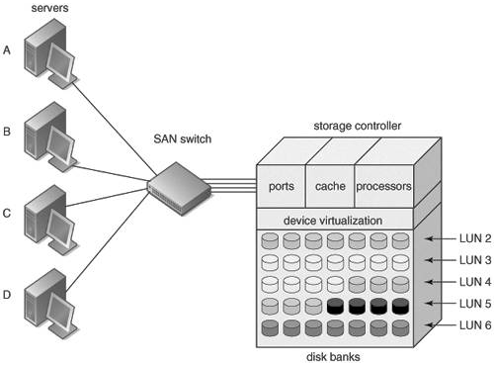
Storage-based Virtualization
Array-based virtualization
Storage controller
Provide basic disk virtualization in the form of RAID management, mirroring, and LUN mapping or masking.
Allocate a single LUN to multiple servers.
Offer Fibre Channel, iSCSI, and SCSI protocol.
Cache memory
Enhance performance.
Storage assets coordination
Coordination between multiple storage systems is necessary to ensure high availability.

Slide 39
Storage-based Virtualization
Data replication
Array-based data replication
Referred to as disk-to-disk replication.
Requires that a storage controller function concurrently as both an initiator and target.
Synchronous vs. Asynchronous
Synchronous data replication ensures that a write operation to a secondary disk array is completed before the primary array acknowledges task completion to the server.
Asynchronous data replication provides write completion by the primary array, although the transaction may still be pending to the secondary array.

Slide 40
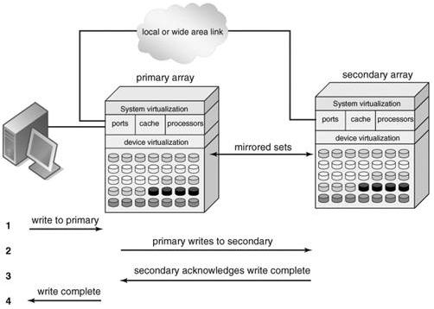
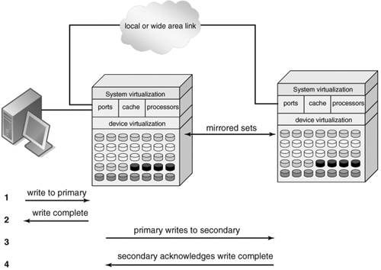
Storage-based Virtualization
Synchronous
Asynchronous
To preserve performance, synchronous data replication is limited to metropolitan distances
Asynchronous data replication is largely immune to transmission latency

Slide 41
Storage-based Virtualization
Other features
Point-in-time copy ( snapshot )
Provide point-in-time copies of an entire storage volume.
Snapshot copies may be written to secondary storage arrays.
Provide an efficient means to quickly recover a known good volume state in the event of data from the host.
Distributed modular virtualization
Decoupling storage controller logic from physical disk banks provides flexibility for supporting heterogeneous disk assets and facilitates distributed virtualization intelligence.
Accommodates class of storage services and data lifecycle management.

Slide 42
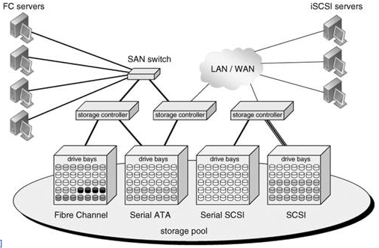
Storage-based Virtualization
Distributed Modular Virtualization
Decoupling storage controller intelligence and virtualization engines from physical disk banks facilitates multi-protocol block data access and accommodation of a broad range of disk architectures.

Slide 43
Storage-based Virtualization
Storage-based implementation
Pros
Provide most of the benefits of storage virtualization
Reduce additional latency to individual IO
Cons
Storage utilization optimized only across the connected controllers
Replication and data migration only possible across the connected controllers and the same vendors devices
Examples
Disk array products

Slide 44
Storage Virtualization
Introduction
What to be virtualized
Where to be virtualized
How to be virtualized

Slide 45
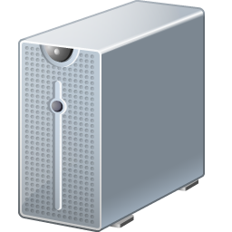

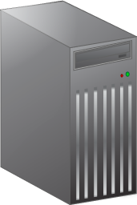

In-band Virtualization
Implementation methods :
In-band
Also known as symmetric, virtualization devices actually sit in the data path between the host and storage.
Hosts perform IO to the virtualized device and never interact with the actual storage device.
Pros
Easy to implement
Cons
Bad scalability & Bottle neck
Control Message
Control Message
Control Message
Control Message
Control Message
Control Message
Data
Data
Data

Slide 46
Out-of-band Virtualization
Implementation methods :
Out-of-band
Also known as asymmetric, virtualization devices are sometimes called metadata servers.
Require additional software in the host which knows the first request location of the actual data.
Pros
Scalability & Performance
Cons
Hard to implement
Control Message
Control Message
Control Message
Control Message
Control Message
Control Message
Data
Data
Data

Slide 47
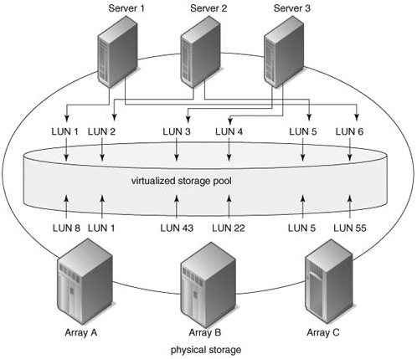
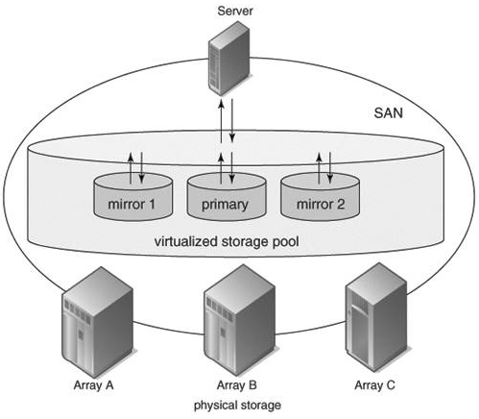
Other Virtualization Services
Pooling Heterogeneous Storage Assets
Heterogeneous Mirroring
In a virtualized storage pool, virtual assets may be dynamically resized and allocated to servers by drawing on the total storage capacity of the SAN
Heterogeneous mirroring offers more flexible options than conventional mirroring, including three-way mirroring within storage capacity carved from different storage systems

Slide 48
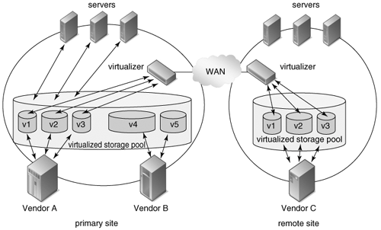
Other Virtualization Services
Heterogeneous Data Replication
Heterogeneous data replication enables duplication of storage data between otherwise incompatible storage systems.

Slide 49
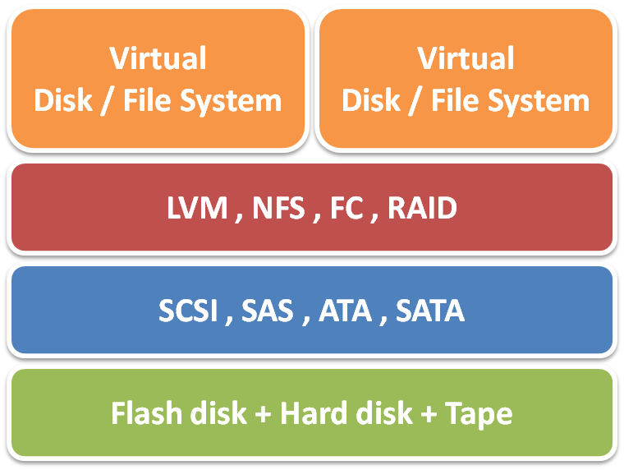
Summary
Storage virtualization technique :
Virtualization layer
File level and block level
Virtualization location
Host, network and storage base
Virtualization method
In-band and out-of-band
Storage virtualization services
Storage pooling and sharing
Data replication and mirroring
Snapshot and multi-pathing

Slide 50
Storage Virtualization
Introduction
What to be virtualized
Where to be virtualized
How to be virtualized
Case study

Slide 51
Storage Virtualization on linux system
Case-study, virtualization on linux system
Block-based
Redundant Array of Independent Disks (RAID)
Logical Volume Management (LVM)
File-based
Network File System (NFS)

Slide 52
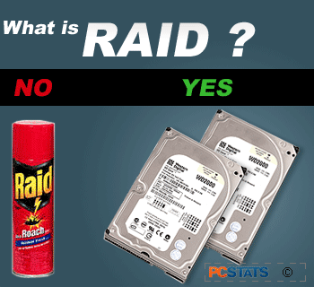
RAID
RAID (redundant array of independent disks)
Originally: redundant array of inexpensive disks
RAID schemes provide different balance between the key goals:
Reliability
Availability
Performance
Capacity

Slide 53

RAID level
The most used:
RAID0
block-level striping without parity or mirroring
RAID1
mirroring without parity or striping
RAID1+0
referred to as RAID 1+0, mirroring and striping
RAID2
RAID3
RAID4
RAID5
block-level striping with distributed parity
RAID5+0
referred to as RAID 5+0, distributed parity and striping
RAID6

Slide 54
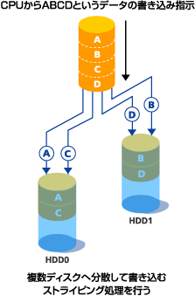
RAID 0
RAID 0: Block-level striping without parity or mirroring
It has no (or zero) redundancy.
It provides improved performance and additional storage
It has no fault tolerance. Any drive failure destroys the array, and the likelihood of failure increases with more drives in the array.
figure from: http://storage-system.fujitsu.com/jp/term/raid/

Slide 55
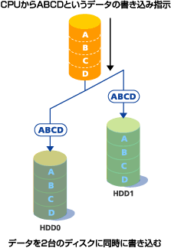
RAID 1
RAID 1: Mirroring without parity or striping
Data is written identically to two drives, thereby producing a "mirrored set";
A read request is serviced by one of the two drives containing with least seek time plus rotational latency.
A write request updates the stripes of both drives. The write performance depends on the slower of the two.
At least two drives are required to constitute such an array.
The array continues to operate as long as at least one drive is functioning.
Space efficiency
1 / N
N = 2
Fault tolerance
N – 1
N = 2
figure from: http://storage-system.fujitsu.com/jp/term/raid/

Slide 56
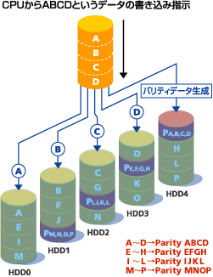
RAID 5
RAID5: Block-level striping with distributed parity
distributes parity on different disk
requires at least 3 disks
Space efficiency
1 − 1/N
Fault tolerance
1
figure from: http://storage-system.fujitsu.com/jp/term/raid/

Slide 57
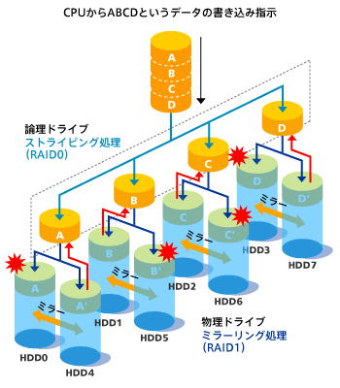
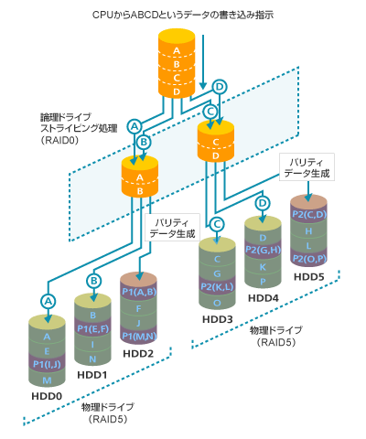
RAID 1+0 / RAID 5+0
RAID 1+0
RAID1(mirror) + Stripe
RAID 5+0
RAID5(parity) + Stripe
figure from: http://storage-system.fujitsu.com/jp/term/raid/

Slide 58
RAID Level Comparison
RAID level | Reliability | Write Performance | Space efficiency
RAID 0 | × | ○ | 2/2
RAID 1 | ◎ | ○ | 1/2
RAID 1+0 | ◎ | ○ | 2/4
RAID 5 | ○ | △ | 2/3
RAID 5+0 | ○ | ○ | 4/6
table from: http://storage-system.fujitsu.com/jp/term/raid/

Slide 59
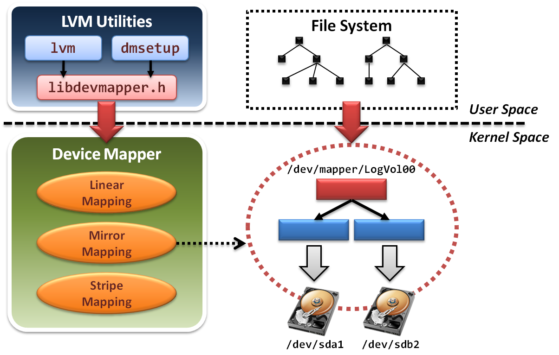
Logical Volume Management
LVM architecture

Slide 60
Logical Volume Management
LVM project is implemented in two components:
In user space
Some management utilities and configuration tools Ex. lvm , dmsetup
Programming interface with a well-designed library Ex. libdevmapper.h
In kernel space
Implement device mapper framework
Provide different mapped device targets Ex. linear , stripe , mirror …etc.

Slide 61
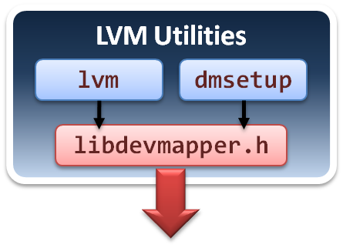
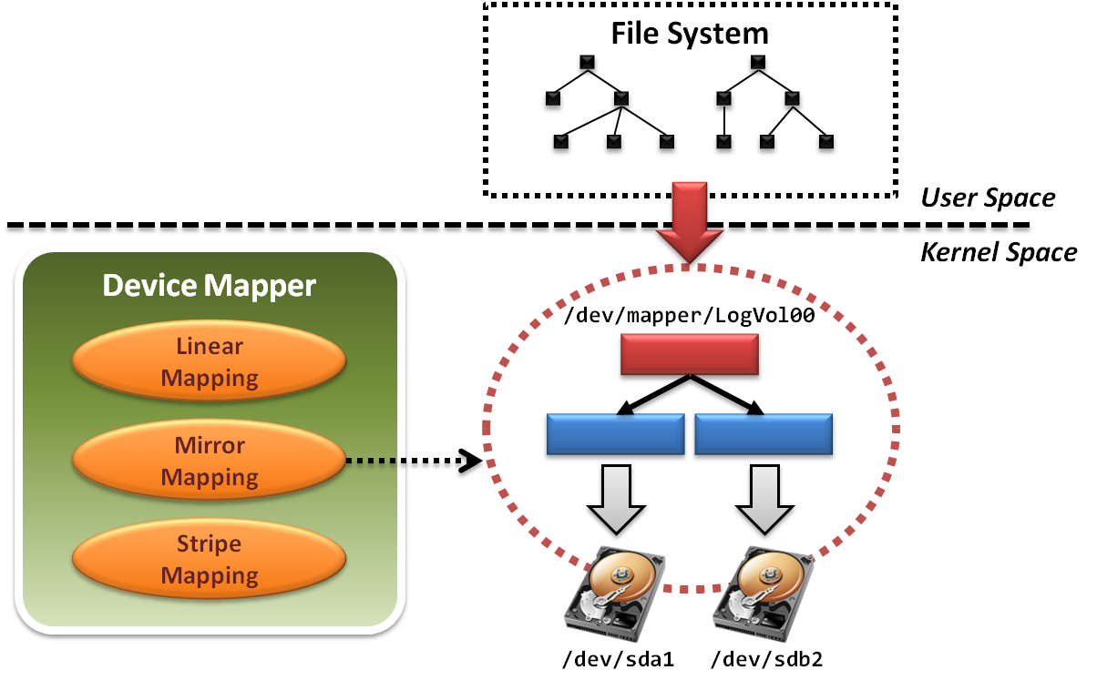
Logical Volume Management
Tools and utilities are in user space.

Slide 62
Logical Volume Management
lvm
Command-line tools for LVM2.
logical volume ( lv ) operations
volume group ( vg ) operations
physical volume ( pv ) operations
Limited controllability
Only can create logical volume with simple mapping mechanisms.
Do not allow cross machine mappings.
dmsetup
Limitations
Still cannot provide cross machine mappings.

Slide 63
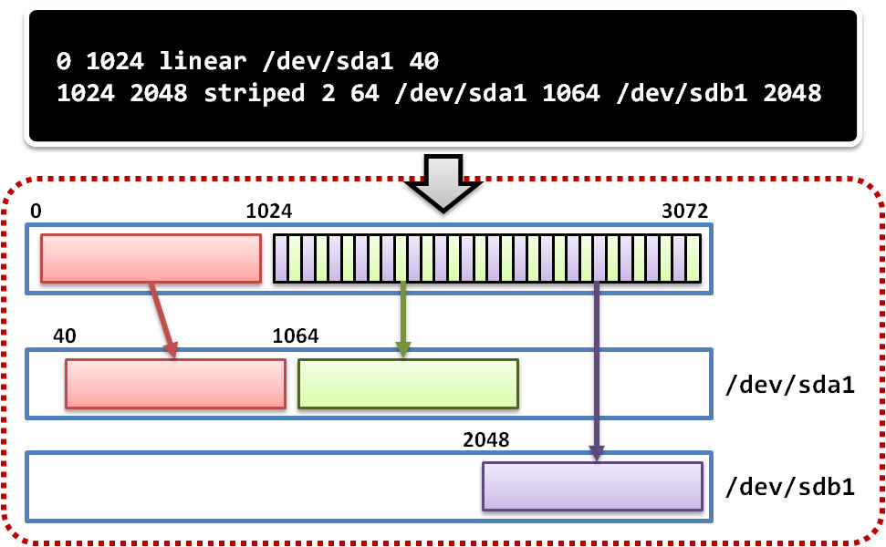
Logical Volume Management
dmsetup
low level logical volume management
Operate create, delete, suspend and resume …etc
Work with mapping table file

Slide 64
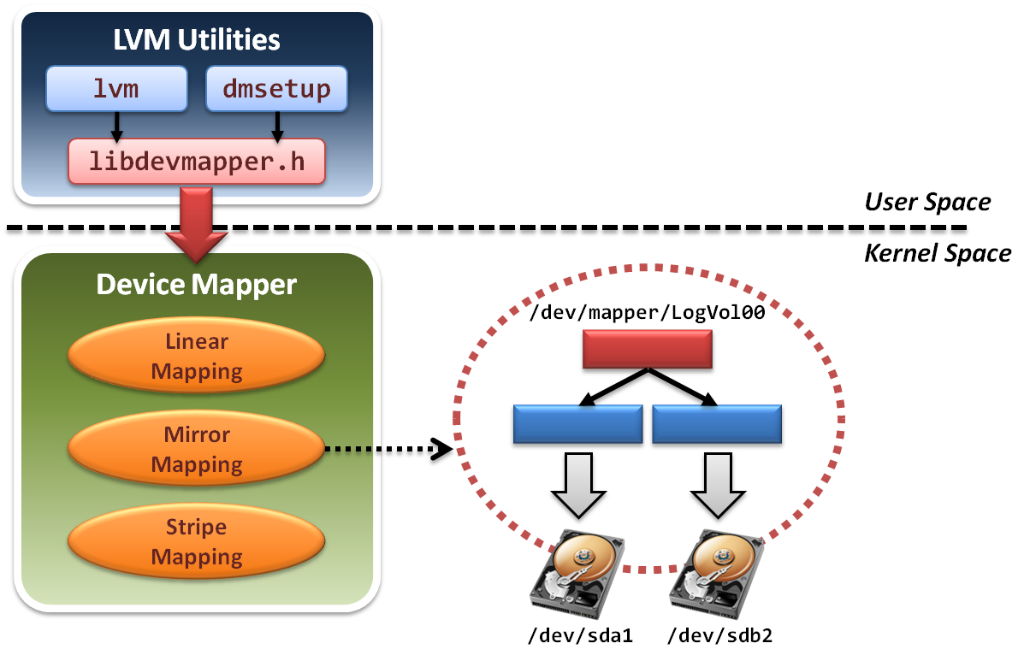
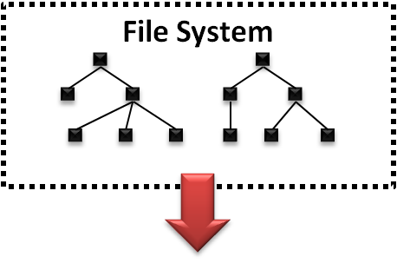
Logical Volume Management
File system will build upon device mapper framework by means of system calls.

Slide 65
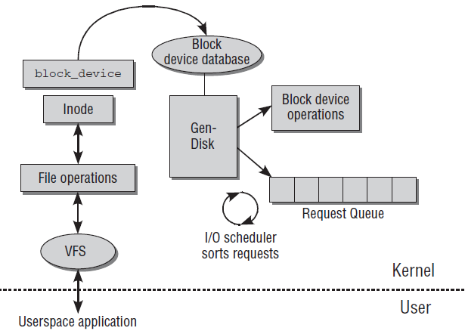
Logical Volume Management
File system in operating system will invoke a set of block device system calls.
Device Mapper framework reload operation functions

Slide 66
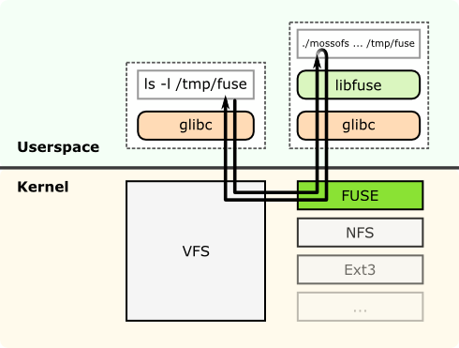
Logical Volume Management
File system can be also implemented in the user space only.

Slide 67
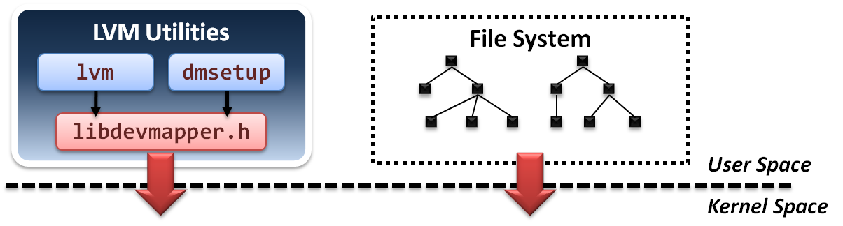
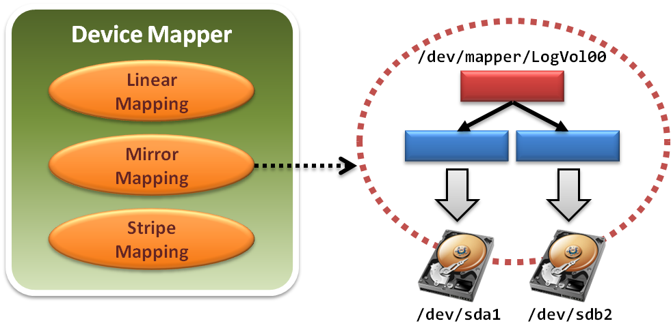
Logical Volume Management
Device mapper framework implements a Linux kernel driver for different mappings.

Slide 68
Logical Volume Management
Device mapper framework defines a set of target device mapping interfaces.
dm_ctr_fn ctr
Initiator of each newly created mapped device
dm_dtr_fn dtr
Destructor of each removing mapped device
dm_map_fn map
Setup the mapping relations
dm_ioctl_fn ioctl
Exactly perform system IO invocations
… etc.

Slide 69

Logical Volume Management
Develop a new mapped device target and add it into device mapper framework.
Improve scalability

Slide 70

Network File System
NFS architecture

Slide 71
Network File System
What is NFS ?
NFS is a POSIX-compliant distributed file system
Work distributedly as server-client model
NFS builds on the Remote Procedure Call (RPC) system.
The Network File System is an open standard defined in RFCs.
Some features :
Shared POSIX file system
Common module in linux kernel
well performance

Slide 72

Network File System
Dynamic Port and its handle
In NFSv3, service listens on random tcp port.
NFS use RPC(Remote Procedure Call) to get the port of service.

Slide 73

Network File System
Consistency and concurrency in NFS
Lockd offers a write lock to handle concurrent update.
Statd handles the consistency between server and clients.

Slide 74
Storage Virtualization in distributed system
Case-study, virtualization in distributed system
Block-based
VastSky
File-based
Lustre
Object-based
Ceph
HDFS

Slide 75
VastSky
Overview
VastSky is a linux-based cluster storage system, which provides logical volumes to users by aggregating disks over a network.
Three kinds of servers
storage manager
Maintaining a database which describes physical and logical resources in a system.
e.g. create and attach logical volumes.
head servers
Running user applications or virtual machines which actually use VastSky logical volumes.
storage servers
Storage servers have physical disks which are used to store user data.
They are exported over the network and used to provide logical volumes on head servers. (iSCSI)

Slide 76


VastSky
VastSky Architecture
XML-RPC
Storage
Manager
iSCSI request
XML-RPC
Storage Pool

Slide 77
VastSky
Logical Volume
a set of several mirrored disks
several physical disk chunks on different servers
Storage Pool
Logical Volume
Storage
Server1
Storage
Server2
There are 3 mirrored disks
and all of them are distributed
in 3 different servers.
Storage
Server3
Storage
Server4

Slide 78
VastSky
Redundancy
VastSky mirrors user data to three storage servers by default and all of them are updated synchronously.
VastSky can be configured to use two networks (e.g. two independent ethernet segments) for redundancy.
Fault detection
The storage manager periodically checks if each head and storage servers are responsive.
Recovery
On a failure, the storage manager attempts to reconfigure mirrors by allocating new extents from other disks automatically.

Slide 79
VastSky
Recovery Mechanism
Storage Pool
Storage
Server1
Logical Volume
Recovering
Storage
Server2
data
1st Network
Attach
Attach
spare
Storage
Server3
crash
Attach
data
Copy
2nd Network
Storage
Server4
data

Slide 80
VastSky
Scalability
Most of cluster file-systems and storage systems which have a meta-data control node have a scalability problem.
VastSky doesn't have this problem since once a logical volume is set up, all I/O operations will be done only through Linux drivers without any storage manager interactions.

Slide 81
VastSky
Load Balance
With VastSky's approach, the loads will be equalized across the physical disks, which leads that it utilizes the I/O bandwidth of them.
Logical Volume
Storage Pool
D1
D2
D3
Storage
Server1
D2
D1
D3
D1
D3
D2
D2
D1
D1
D1
D1
D3
D2
D2
D1
Storage
Server2
D3
D1
D3
D2
D3
D1
D2
D3
D3
Storage
Server3
D3
D1
D1
D1
D2
D2
D2
D3
D3
D1
D2
D1
D2
D2
D3
Storage
Server4
D3
D2
D3
D2
D1
D3

Slide 82

Lustre File System
What is Lustre ?
Lustre is a POSIX-compliant global, distributed, parallel filesystem.
Lustre is licensed under GPL.
Some features :
Parallel shared POSIX file system
Scalable
High performance
Petabytes of storage
Coherent
Single namespace
Strict concurrency control
Heterogeneous networking
High availability

Slide 83
Lustre File System
Lustre components :
Metadata Server (MDS)
The MDS server makes metadata stored in one or more MDTs.
Metadata Target (MDT)
The MDT stores metadata (such as filenames, permissions) on an MDS.
Object Storage Servers (OSS)
The OSS provides file I/O service, and network request handling for one or more local OSTs.
Object Storage Target (OST)
The OST stores file data as data objects on one or more OSSs.
Lustre network :
Supports several network types
Infiniband, TCP/IP on Ethernet, Myrinet, Quadrics, …etc.
Take advantage of remote direct memory access (RDMA)
Improve throughput and reduce CPU usage

Slide 84

Lustre File System

Slide 85

Lustre File System
Lustre in HPC
Lustre is the leading HPC file system
15 of Top 30
Demonstrated scalability
Performance
Systems with over 1,000 nodes
190 GB/sec IO
26,000 clients
Examples
Titan supercomputer at Oak Ridge National Laboratory
TOP500: #1, November 2012
System at Lawrence Livermore National Laboratory (LLNL)
Texas Advanced Computing Center (TACC)

Slide 86

Ceph
Overview
Ceph is a free software distributed file system.
Ceph's main goals are to be POSIX-compatible, and completely distributed without a single point of failure.
The data is seamlessly replicated, making it fault tolerant.
Release
On July 3, 2012, the Ceph development team released Argonaut, the first release of Ceph with long-term support.

Slide 87
Ceph
Introduction
Ceph is a distributed file system that provides excellent performance ,reliability and scalability.
Objected-based Storage.
Ceph separates data and metadata operations by eliminating file allocation tables and replacing them with generating functions.
Ceph utilizes a highly adaptive distributed metadata cluster, improving scalability.
Using object-based storage device (OSD) to directly access data, high performance.

Slide 88

Ceph
Objected-Based Storage

Slide 89
Ceph
Goal
Scalability
Storage capacity, throughput, client performance. Emphasis on HPC.
Reliability
Failures are the norm rather than the exception, so the system must have fault detection and recovery mechanism.
Performance
Dynamic workloads → Load balance.

Slide 90

Ceph
Three main components
Clients : Near-POSIX file system interface.
Cluster of OSDs : Store all data and metadata.
Metadata server cluster : Manage namespace (file name).

Slide 91
Three Fundamental Design
Separating Data and Metadata
Separation of file metadata management from the storage.
Metadata operations are collectively managed by a metadata server cluster.
User can direct access OSDs to get data by metadata.
Ceph removed data allocation lists entirely.
Usr CRUSH assigns objects to storage devices.

Slide 92

Separating Data and Metadata
Ceph separates data and metadata operations

Slide 93
Separating Data and Metadata
CRUSH(Controlled Replication Under Scalable Hashing)
CRUSH is a scalable pseudo-random data distribution function designed for distributed object-based storage systems .
Define some simple hash functions.
Use hash functions to efﬁciently map data objects to storage devices without relying on a central directory.
Advantages
Because using hash functions, client can calculate object location directly.

Slide 94
Separating Data and Metadata
CRUSH(x) → (osd_{n1}, osd_{n2}, osd_{n3})
Inputs
x is the placement group
Hierarchical cluster map
Placement rules
Outputs a list of OSDs
Advantages
Anyone can calculate object location
Cluster map infrequently updated

Slide 95

Separating Data and Metadata
Data Distribution with CRUSH
In order to avoid imbalance (OSD idle, empty) or load asymmetries (hot data on new device). →distributing new data randomly.
Use a simple hash function, Ceph maps objects to Placement groups (PGs). PGs are assigned to OSDs by CRUSH.

Slide 96

Dynamic Distributed Metadata Management
Dynamic Distributed Metadata Management
Ceph utilizes a metadata cluster architecture based on Dynamic Subtree Partitioning.(workload balance)
Dynamic Subtree Partitioning
Most FS ,use static subtree partitioning →imbalance workloads. →simple hash function can get directory.
Ceph’s MDS cluster is based on a dynamic subtree partitioning. →balance workloads

Slide 97
Reliable Distributed Object Storage
Reliable Autonomic Distributed Object Storage
Replica.
Failure Detection and Recovery.

Slide 98
Client
Client Operation
File I/O and Capabilities
Translate file name into inode(inode number, file owner, mode, size, …)
Request
MDS
Client
(open file)
Check OK, return
Direct
access
Return inode number, map file data into objects(CRUSH)
OSD

Slide 99
Client
Client Synchronization
If multiple clients (readers and writers) use the same file, cancel any previously read and write requests until OSD check OK.
Traditional: Update serialization. → Bad performance
Ceph: Use for HPC (high-performance computing community) can read and write different parts of same file (diff objects). → increase performance

Slide 100
Metadata
Dynamically Distributed Metadata
MDSs use journaling
Repetitive metadata updates handled in memory.
Optimizes on-disk layout for read access.
Per-MDS has journal (usually a circular log in a dedicated area of the file system), when MDS failure another node can quickly recover with journal.
Inodes are embedded directly within directories.
Each directory’s content is written to the OSD cluster using the same striping and distribution strategy as metadata journals and file data.

Slide 101

Replica
Replication
Data is replicated in terms of PGs.
Clients send all writes to the first non-failed OSD in an object’s PG (the primary), which assigns a new version number for the object and PG; and forwards the write to any additional replica OSDs.

Slide 102
Failure detection
Failure detection
When OSD not response → sign “down”
Pass to the next OSD.
If first OSD doesn’t recover →sign “out”
Another OSD join.

Slide 103
Recovery
Recovery and Cluster Updates
If OSD1 crashes → sign “down”
The OSD2 takes over as primary.
If OSD1 recovers → sign “up”
The OSD2 receives update request, sent new version data to OSD1.

Slide 104
HDFS
Overview
HDFS(Hadoop Distributed File System).
Reference from Google File System.
A scalable distributed file system for large data analysis.
Based on commodity hardware with high fault-tolerant.
The primary storage used by Hadoop applications.
Cloud Applications
MapReduce
Hbase
Hadoop Distributed File System (HDFS)
A Cluster of Machines

Slide 105

Hadoop
Introduction
An Apache project
A distributed computing platform
A software framework that lets one easily write and run applications that process vast amounts of data
From three papers
SOSP 2003 : “The Google File System”
OSDI 2004 : “MapReduce : Simplifed Data Processing on Large Cluster”
OSDI 2006 : “Bigtable: A Distributed Storage System for Structured Data”

Slide 106
Hadoop Features
Efficiency
Process in parallel on the nodes where the data is located
Robustness
Automatically maintain multiple copies of data and automatically re-deploys computing tasks based on failures
Cost Efficiency
Distribute the data and processing across clusters of commodity computers
Scalability
Reliably store and process massive data

Slide 107

HDFS Architecture

Slide 108
HDFS Architecture
NameNode
The file content is split into blocks (default 128MB,3 replica).
Files and directories are represented on the NameNode by inodes (permissions, modification and access times, namespace and disk space quotas).
Namespace is a hierarchy of files and directories.
NameNode maintains the namespace tree and the mapping of file blocks to DataNodes.
Three components
Image: the inode data and the list of blocks (name system).
Checkpoint: the persistent record of the image (file system).
Journal: the modification log of the image (file system).

Slide 109
HDFS Architecture
Image and Journal
When Startup NameNode
Load checkpoint.
Use journal.
CheckpointNode
The CheckpointNode periodically combines the existing checkpoint and journal to create a new checkpoint and an empty journal.
The CheckpointNode downloads checkpoint and journal from NameNode and return a new checkpoint and an empty journal.
BackupNode
The BackupNode always follows journal to keep NameNode latest version.
If NameNode fails, use BackupNode untill NameNode recovers.

Slide 110
HDFS Architecture
DataNode
Each block replica on a DataNode is represented by two files:
Data
Block’s metadata (checksum, generation stamp)
When startup DataNode, NameNode performs handshaking:
Verify the name space ID.
Verify the soft version.
A new DataNode will receive namespace ID .
After the handshaking the DataNode registers will get Storage ID.
A DataNode identifies block replicas in its possession to the NameNode by sending a block report (block ID, generation stamp). (1 time/hr)
Hearbeats: 1 time/3 sec

Slide 111

HDFS Client

Slide 112

HDFS Client
File Write
HDFS implements a single-writer, multiple-reader model.
The writing client periodically renews the lease by heartbeat:
Soft limit: client fails to renew the lease, another client can preempt.
Hard limit: client fails to renew the lease, the client quit and close file.
Form a pipeline.
A full packet buffer is pushed to the pipeline.

Slide 113
HDFS Client
File Read
When a client opens a file to read, it fetches the list of blocks and the locations of each block replica from the NameNode.
Read from the nearest replica first. If fails, read from the next nearest replica.

Slide 114

REPLICA MANGEMENT
Block Placement
When a DataNode registers to the NameNode, the NameNode runs a configured script to decide which rack the node belongs to.
The default HDFS block placement policy provides a tradeoff between minimizing the write cost, and maximizing data reliability.
The default HDFS replica placement policy:
No DataNode contains more than one replica of any block.
No rack contains more than two replicas of the same block.

